Slide 1


The Runner
Game Design by Craig Kane
Art By: Mark Chang

Slide 2
Concept
The Runner is a First-Person speed running game where the player is given various powerups that aid the player in overcoming the various obstacles throughout the map. These include a multi-jump that allows multiple consecutive jumps, a dash move that gives the player a burst of speed capable of dashing over a great distance in the air, wall running, and sliding down an incline for a boost of speed. The overall goal is to get the fastest time possible.

Slide 3
Rules
No Win or Lose conditions.
Game ends when player crosses finish line.
There is a spawn point at the start of the map and checkpoints at various points.
There is a Fall Zone that resets the player at the last checkpoint.
The objective is to run the map the fastest. A leaderboard will be tracking the times.
Powerups will be given to the player to help overcome the obstacles.

Slide 4
Requirements
Character Controller
Textures for Tutorial
Textures for Main Game
Modified code for player movement
Menu System
Code for keeping track of times
Spawn Point at start
Finish Area at end
Platforms as obstacles
Hazard Area in Main Game
Checkpoints
Music
Sound Effects
Powerup prefabs
Particle System for Powerups
Animation of Powerups
A HUD keeping count of powerups and time

Slide 5
Gameplay
The player starts with easy to overcome obstacles that don’t require the use of the powerups. The difficulty increases as the player get closer to the goal. The obstacles will require the use of multiple jumps to get high enough or a chasm that must be dashed across. The final challenges will have no platforms and the user must string together the powerups as they collect them. Various other obstacles that don’t require any powerups will be dispersed throughout the level including walls that can be run on and inclines that can be slid down to increase speed enough to clear a gap.

Slide 6
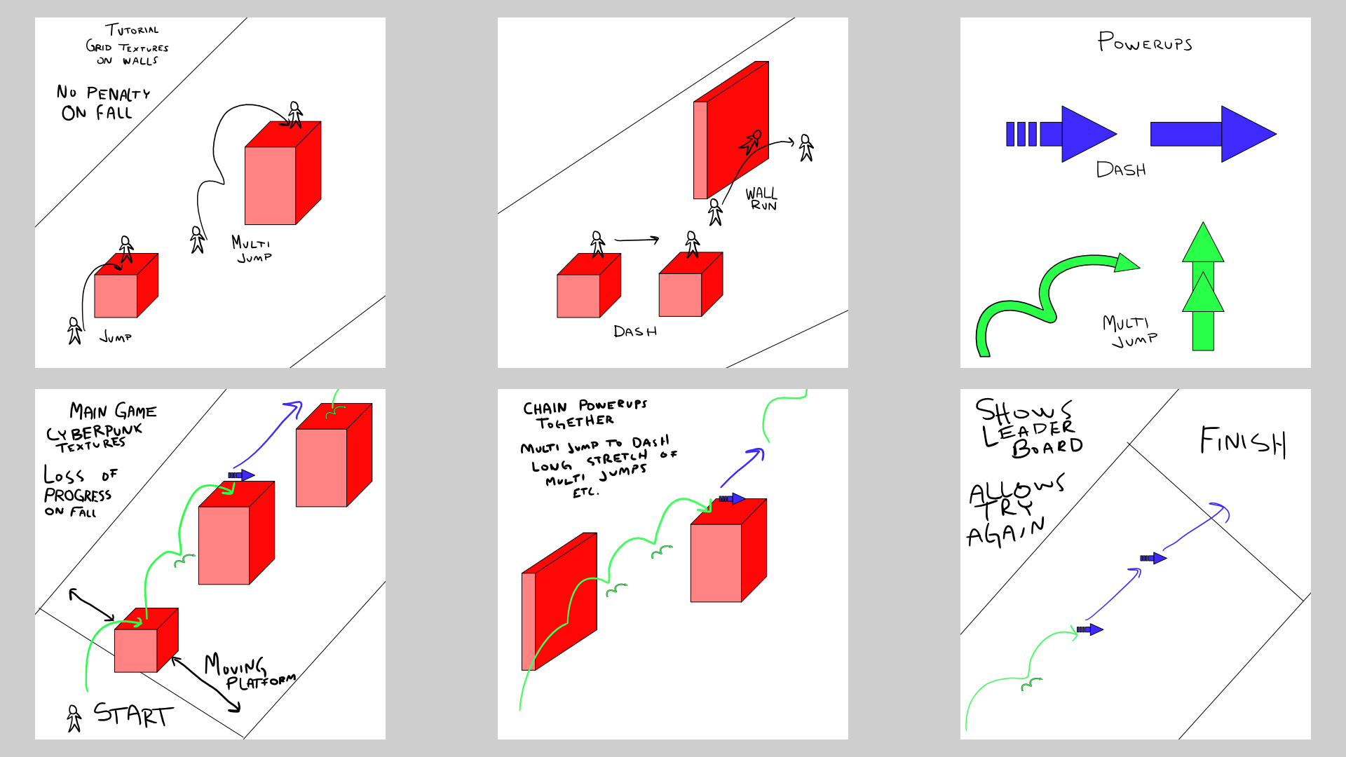
Layout

Slide 7
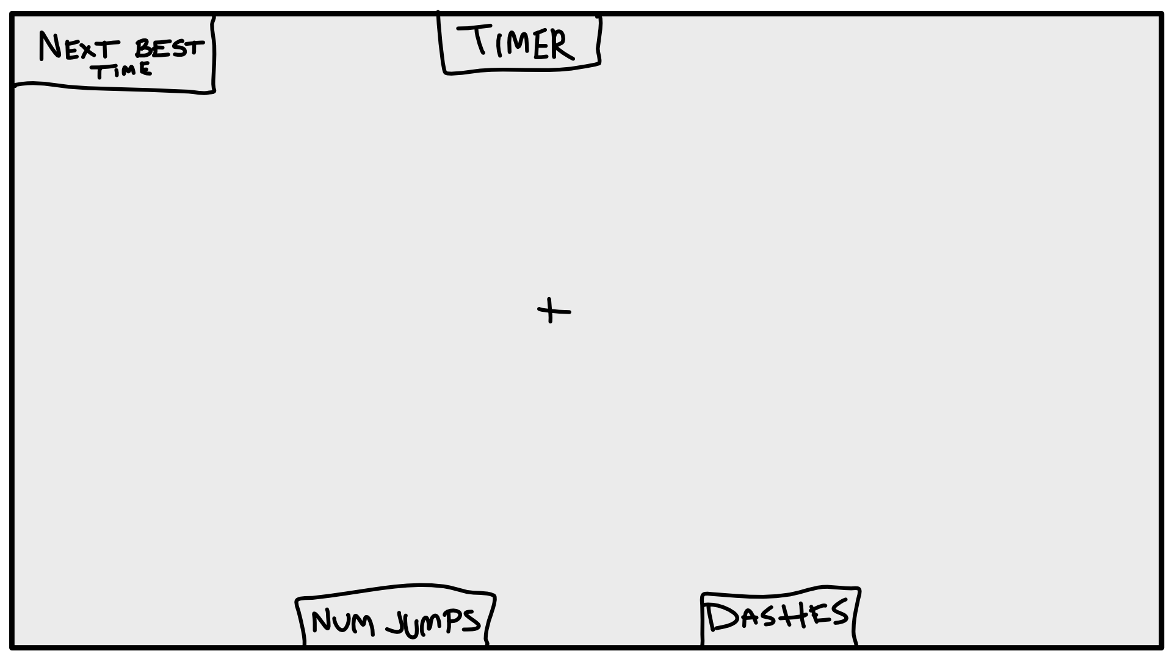
Layout HUD

Slide 8
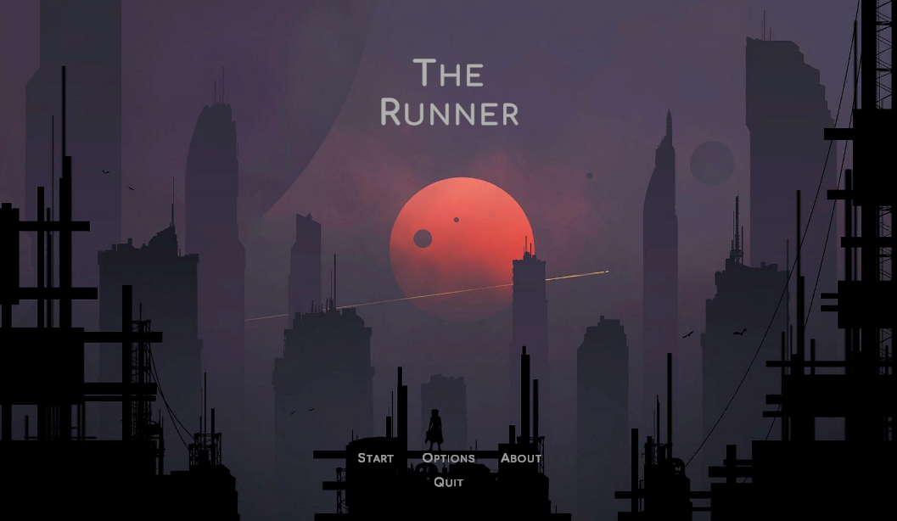
Game Start Main Menu

Slide 9
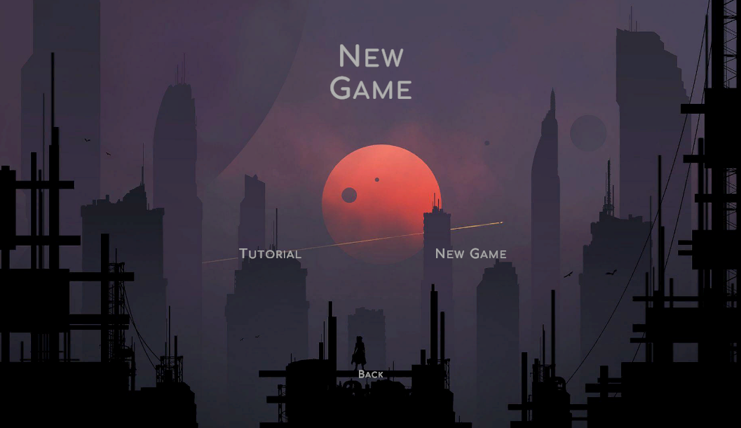
Game Start New Game

Slide 10
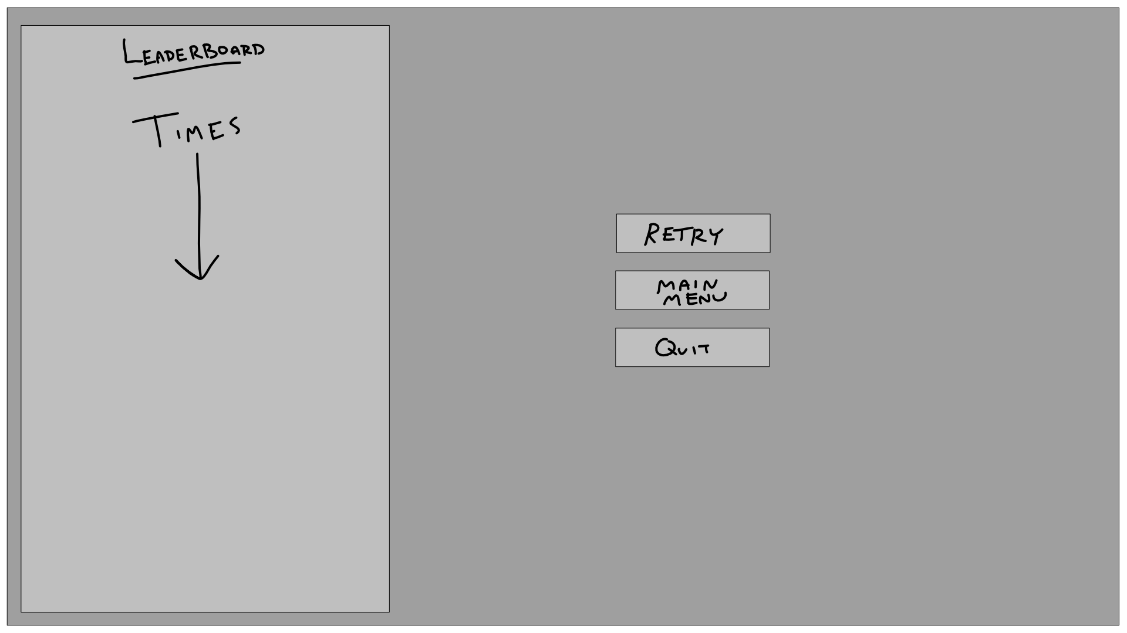
Game End

